Slide 1
Sustainable Tourism Beyond the Beach

Slide 2
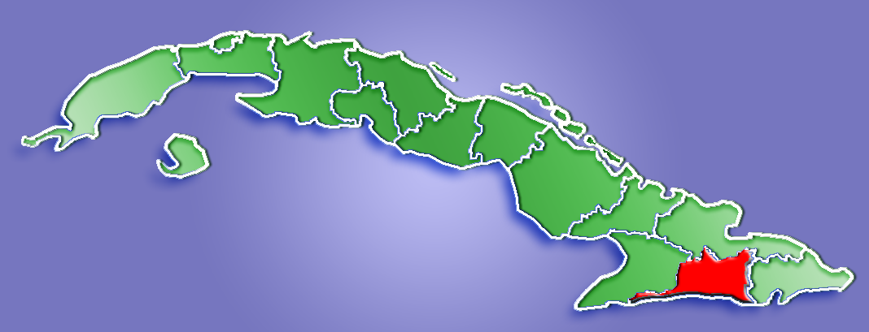
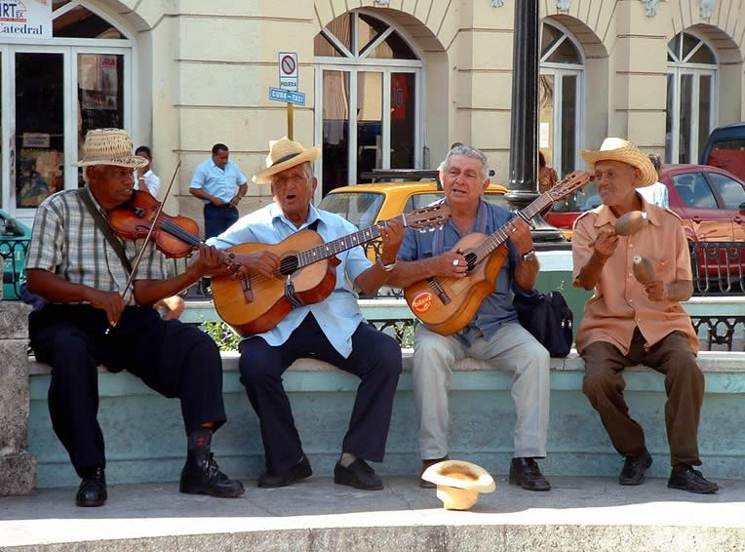
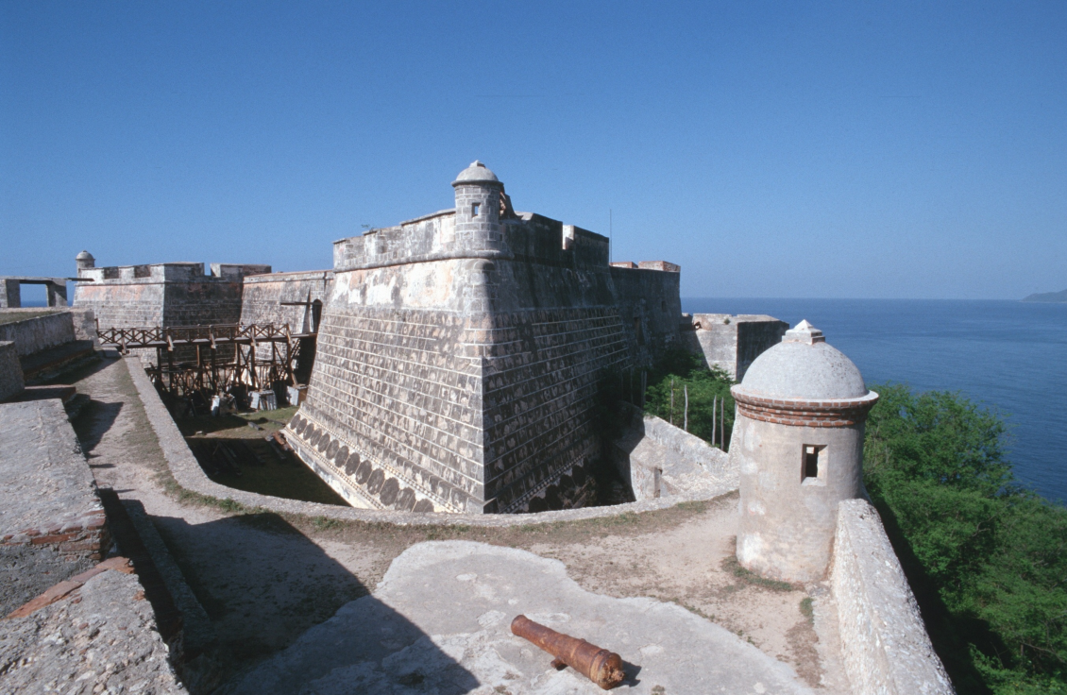
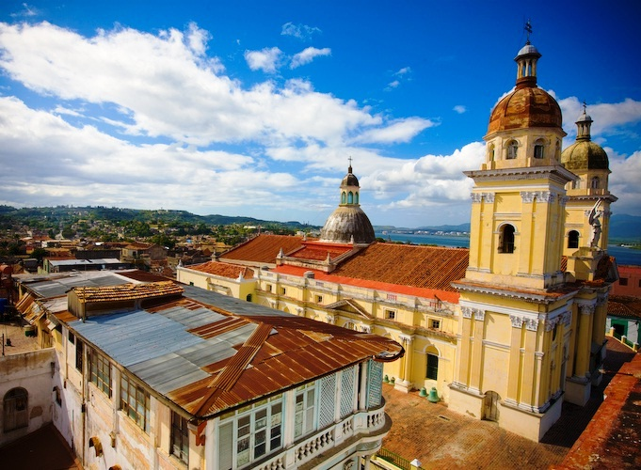
Santiago de Cuba
UNESCO World Heritage Site

Slide 3
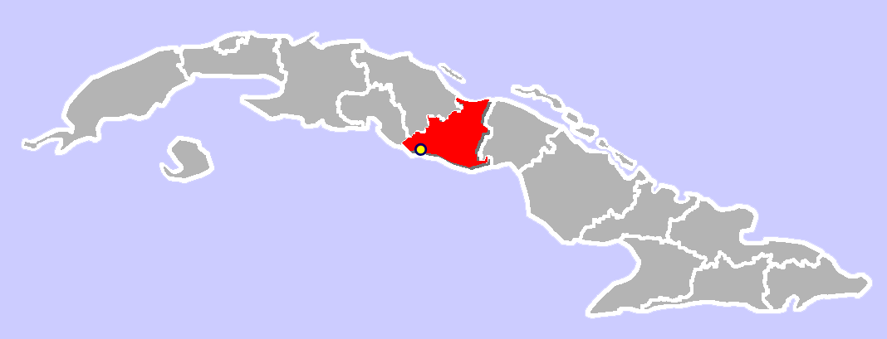
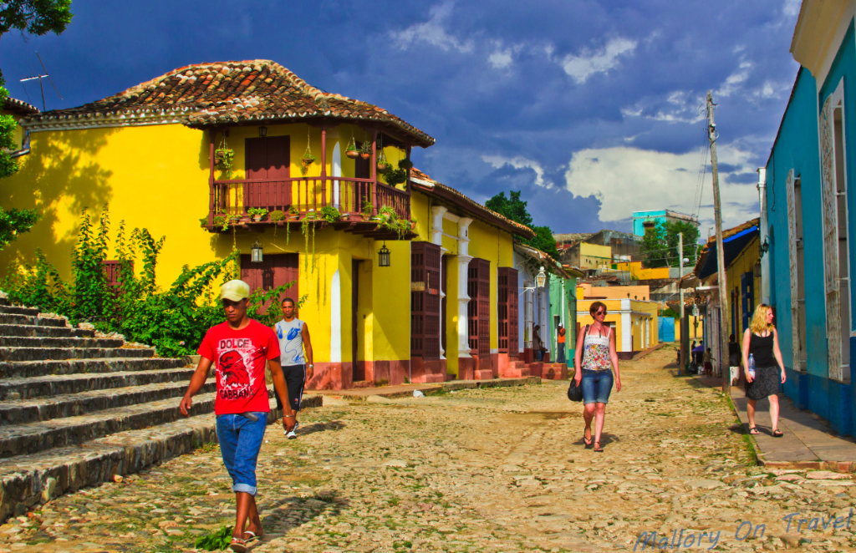
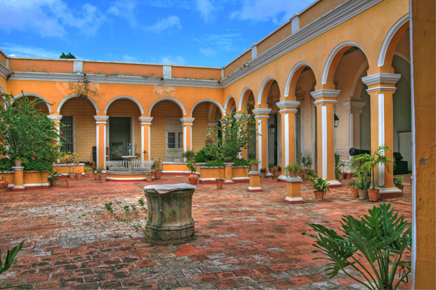
Trinidad de Cuba
UNESCO World Heritage Site

Slide 4
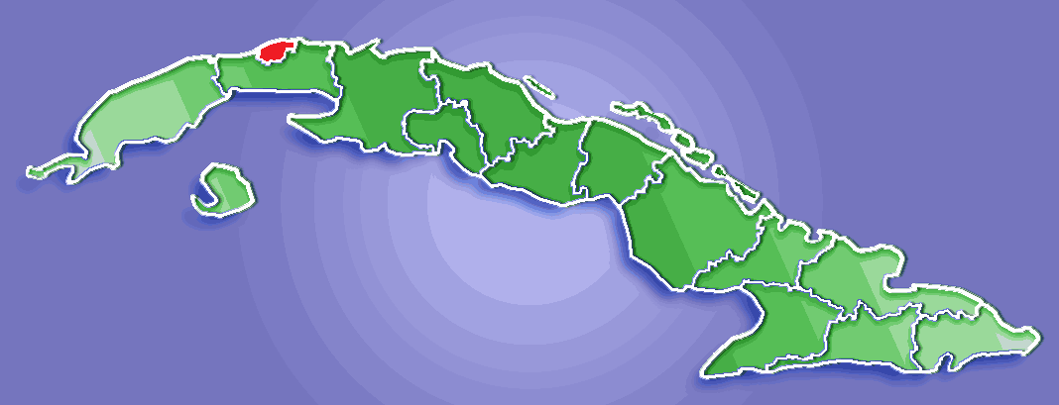
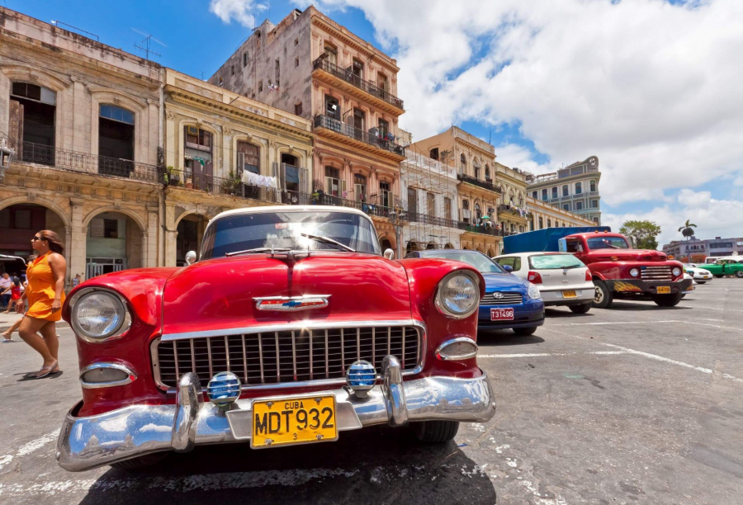
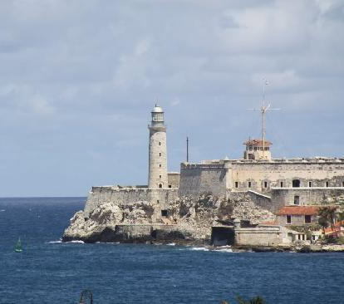
Havana, Cuba
UNESCO World Heritage Site, 1982

Slide 5
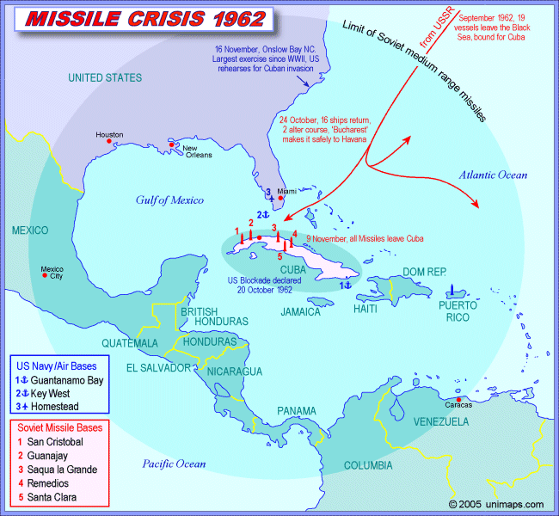
After the 1962 crisis and the US embargo, US tourism and investment quickly moved out of Cuba.
First to Bahamas and Puerto Rico.
Then into the Eastern Caribbean.
What happens as Cuba opens up again?

Slide 6
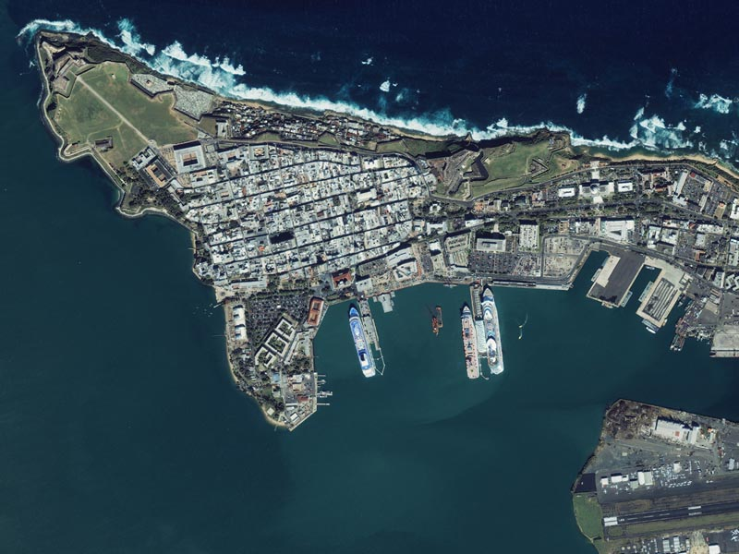
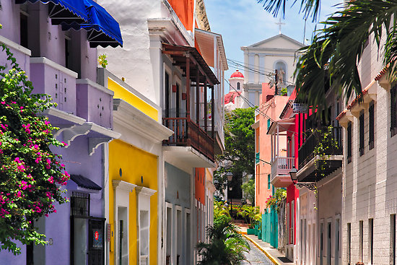
El Morro Fortress San Juan
Puerto Rico
Old San Juan, Puerto Rico and
El Morro Fortress.

Slide 7
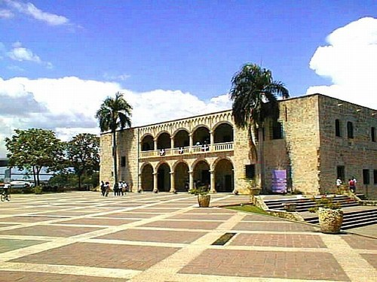
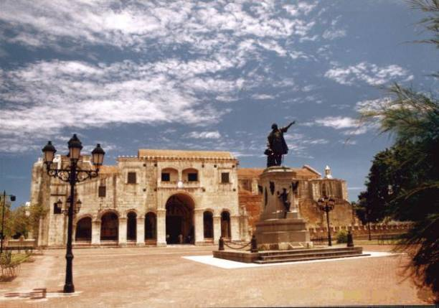
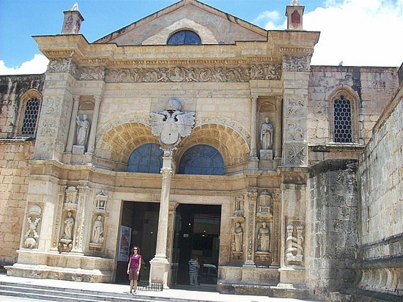
The colonial city of Santo Domingo, Dominican Republic
Colonial city of Santo Domingo

Slide 8
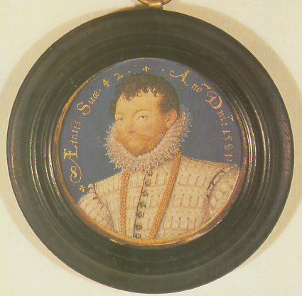
Francis Drake’s attack and capture of the city of Santo Domingo in 1586

Slide 9
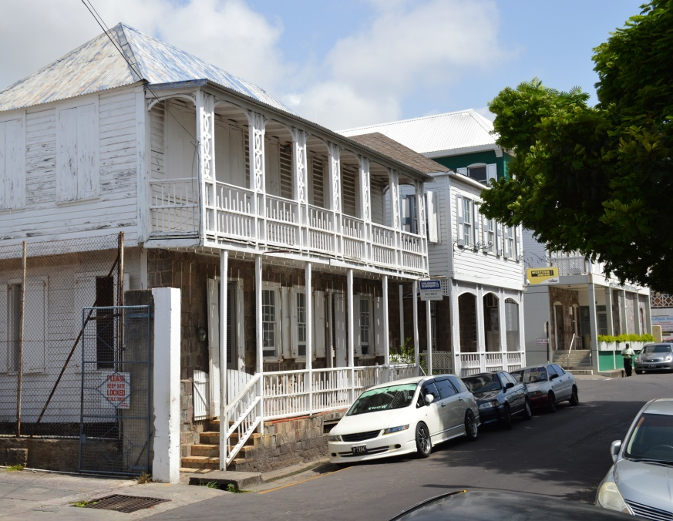
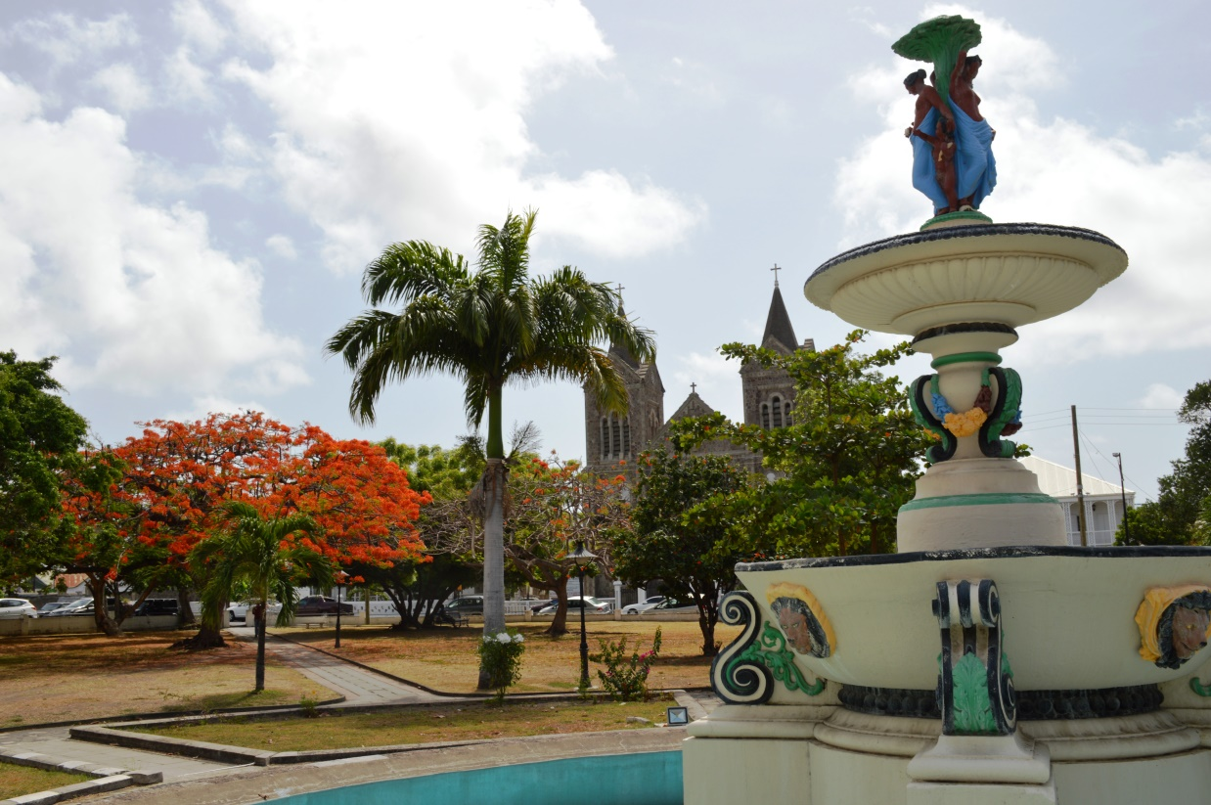
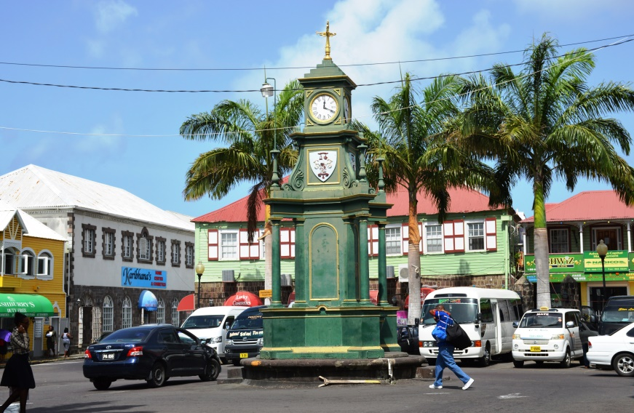
Basseterre, St. Kitts

Slide 10
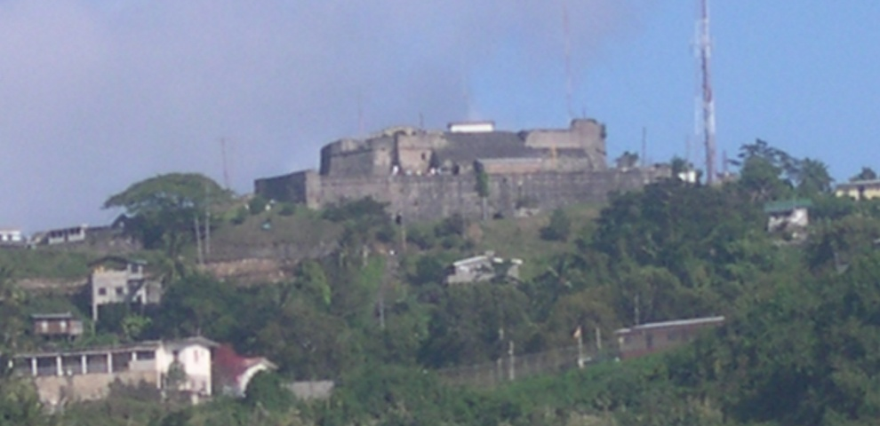
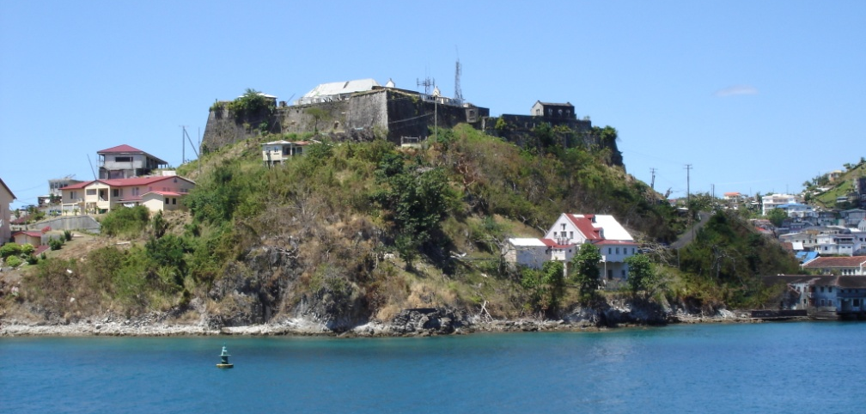
St.Georges, Grenada

Slide 11
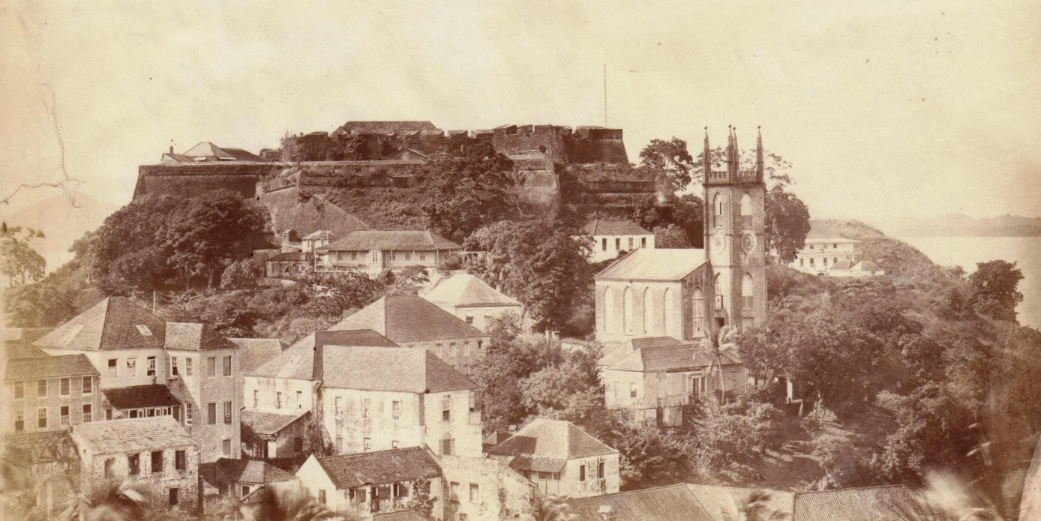
Fort George, Grenada:
1880 and 2015
Fort George and St. Georges, Grenada

Slide 12
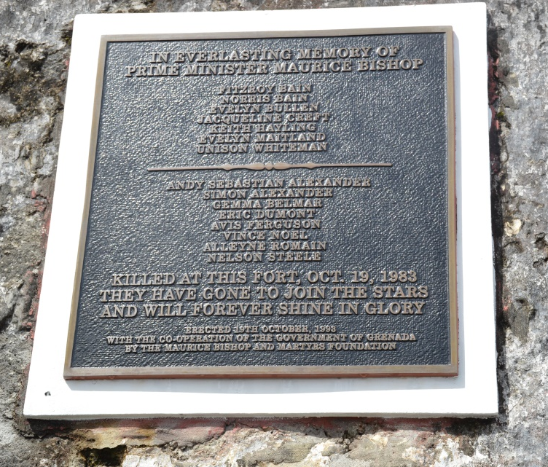
The central courtyard of
Fort George and wall of
execution of 19th October 1983

Slide 13
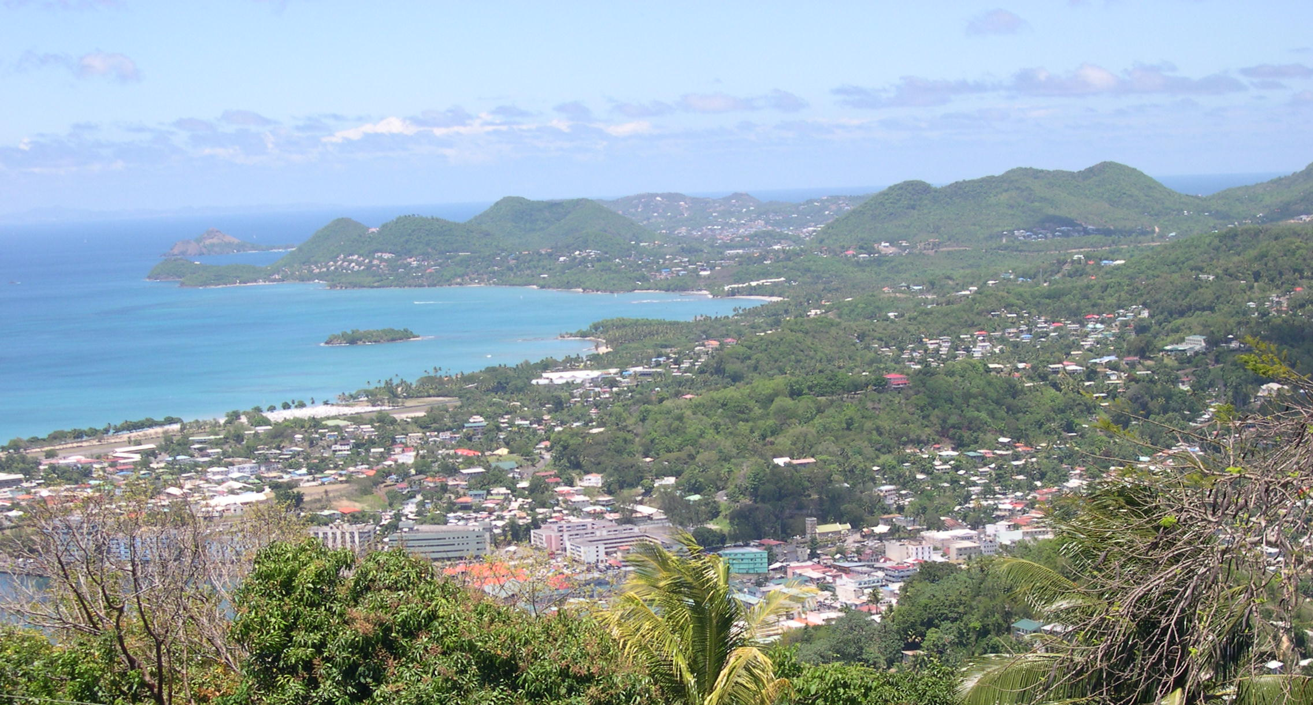
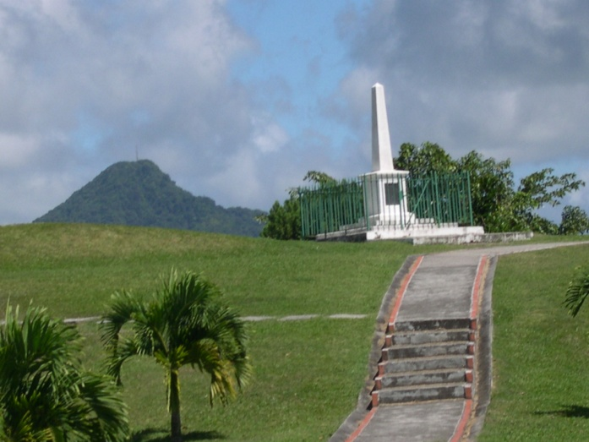
Castries and Morne Fortune, St.Lucia
Morne Fortune, 1784

Slide 14
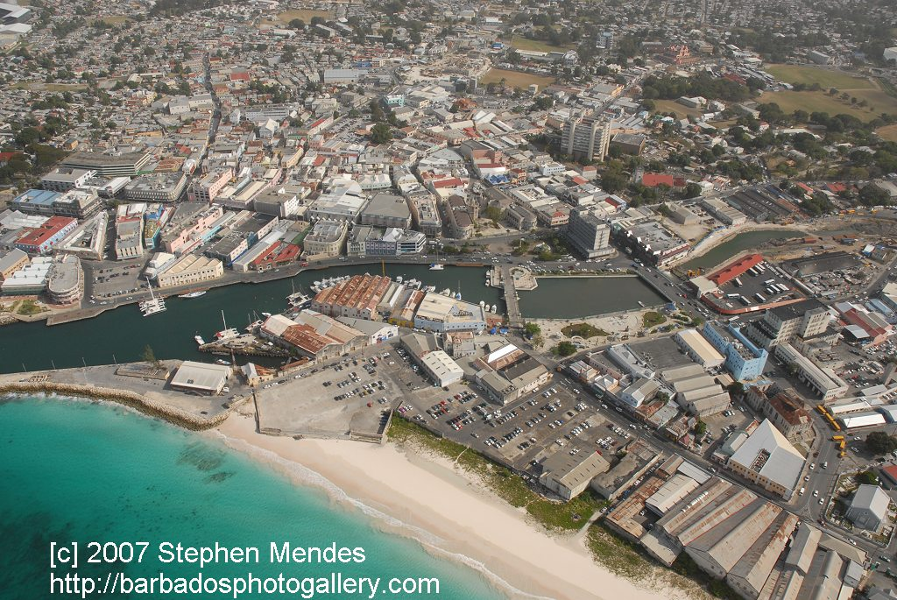
21st century needs in a 17th century space
Bridgetown, Barbados

Slide 15
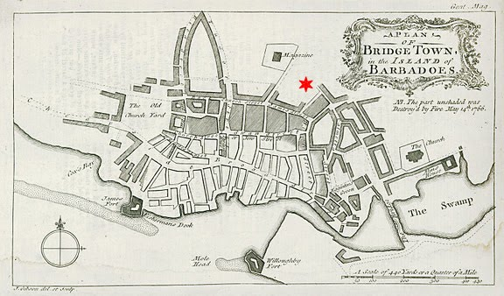
Plan of Bridgetown 1766

Slide 16
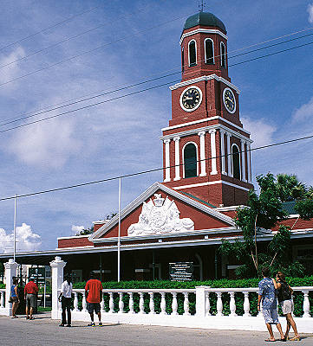
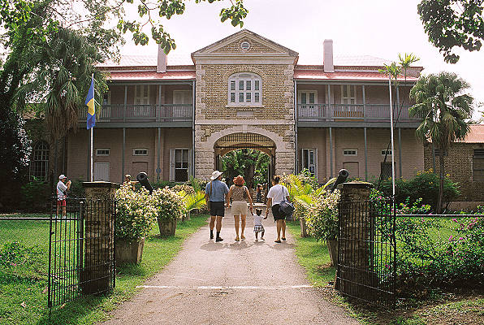
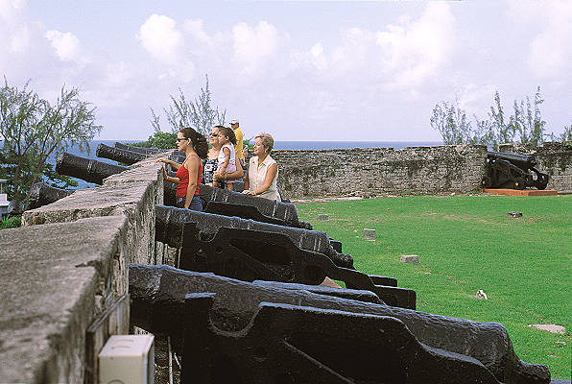
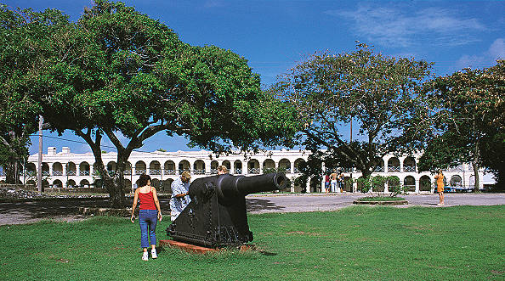
The Barbados Garrison

Slide 17
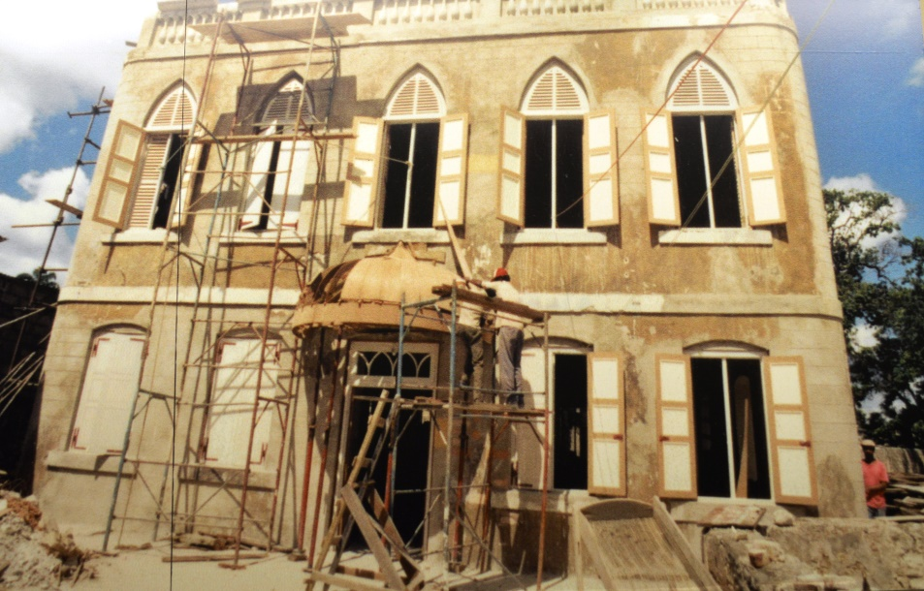
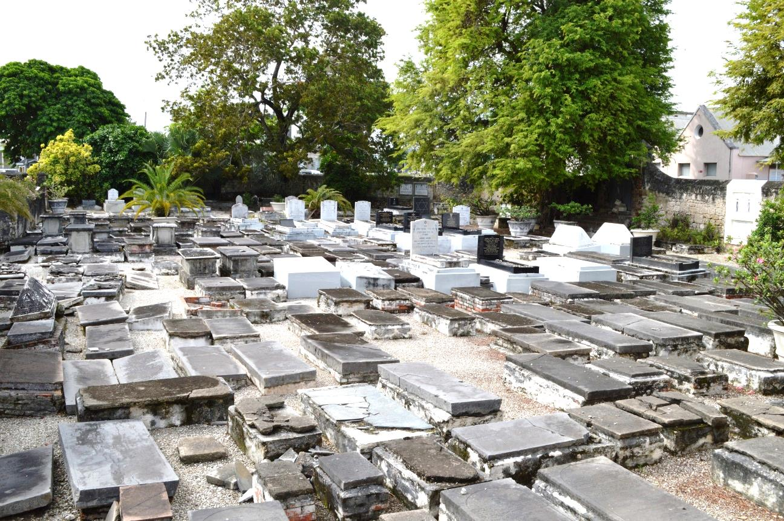
Places of worship have a lasting interest and usually are in continuous use for their original purpose.

Slide 18
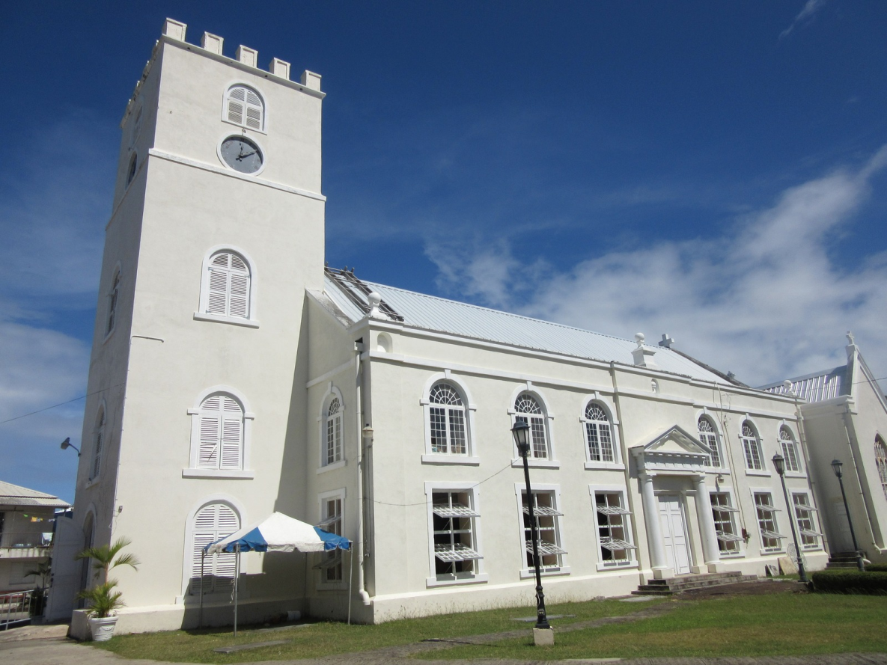
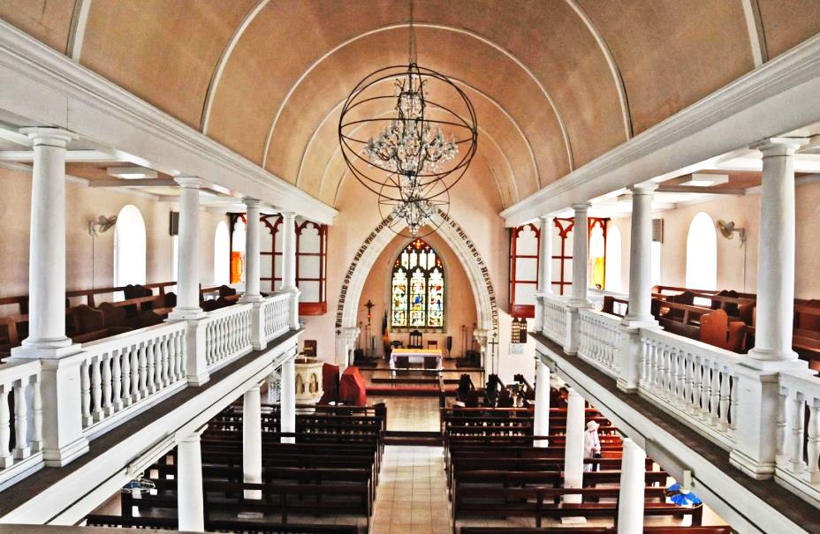
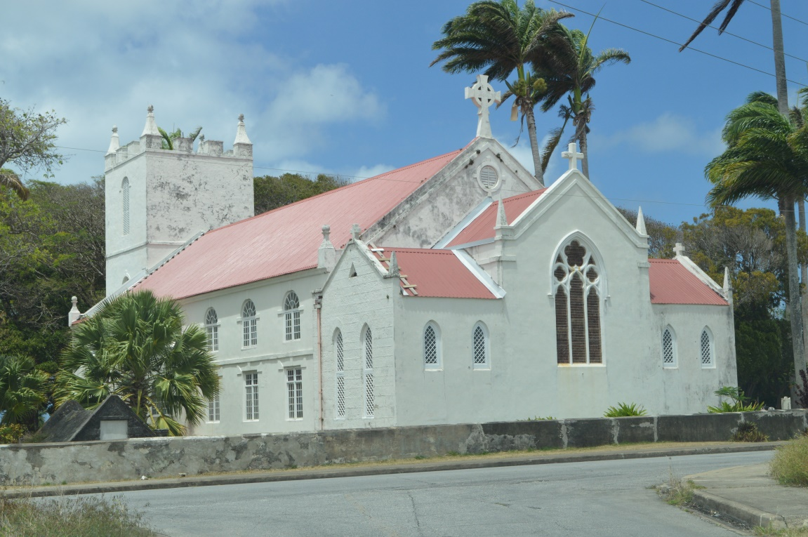
Places of worship have a lasting interest and usually are in continuous use for their original purpose.

Slide 19
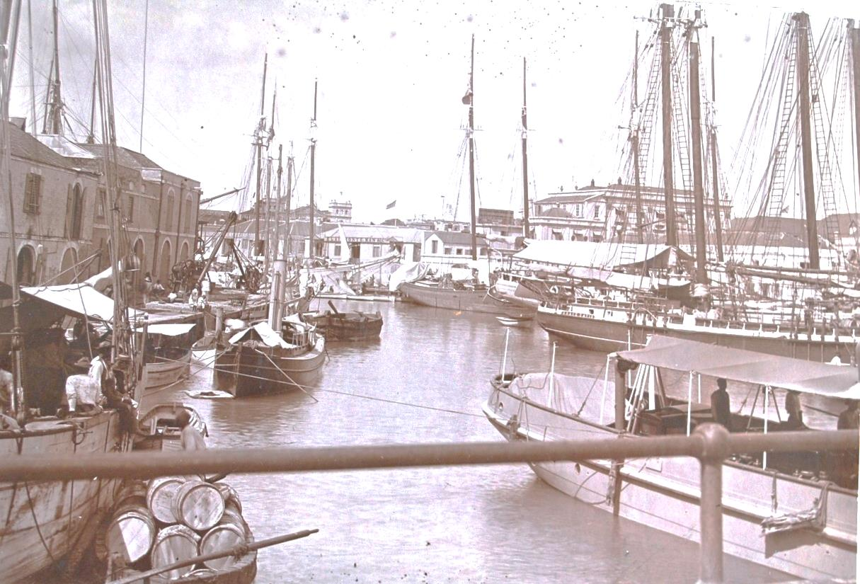
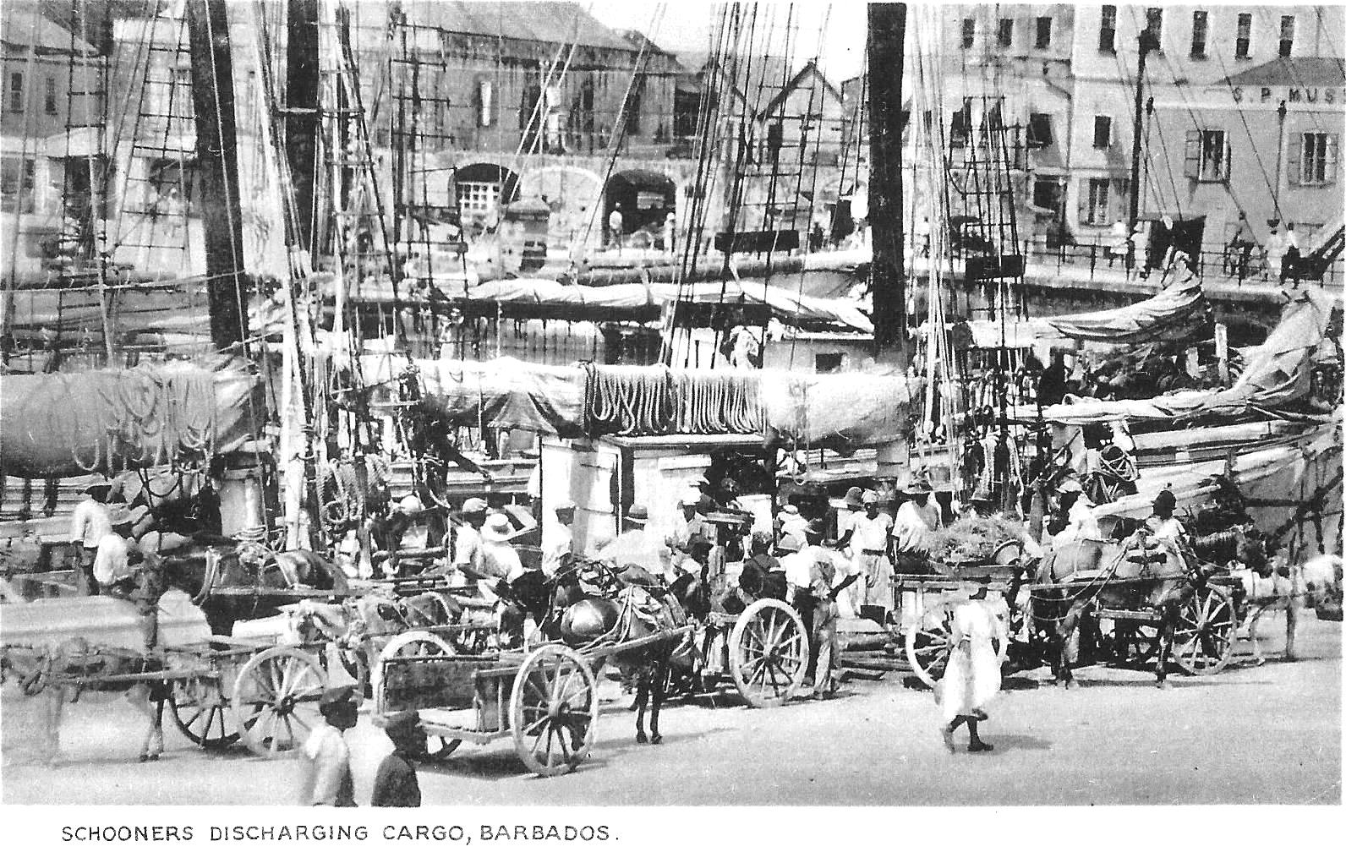
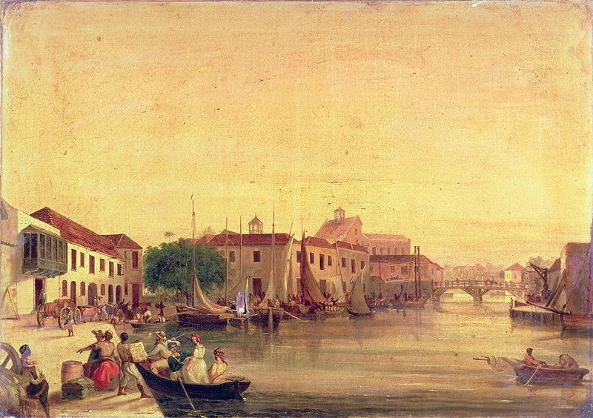
Bridgetown was a busy port city and commercial centre for the islands of the Eastern Caribbean.

Slide 20
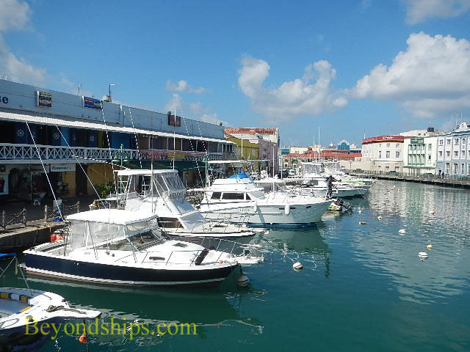
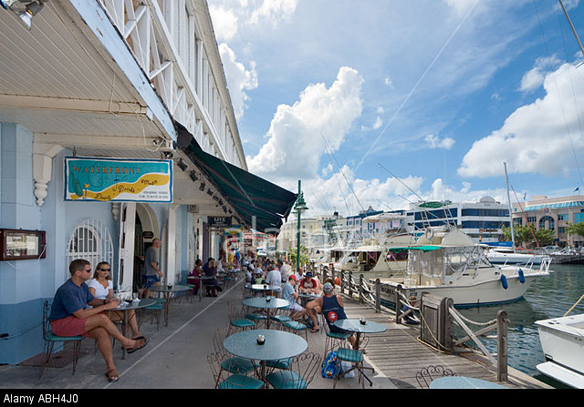
Adaptive use in the same space supported by another type of economic model

Slide 21
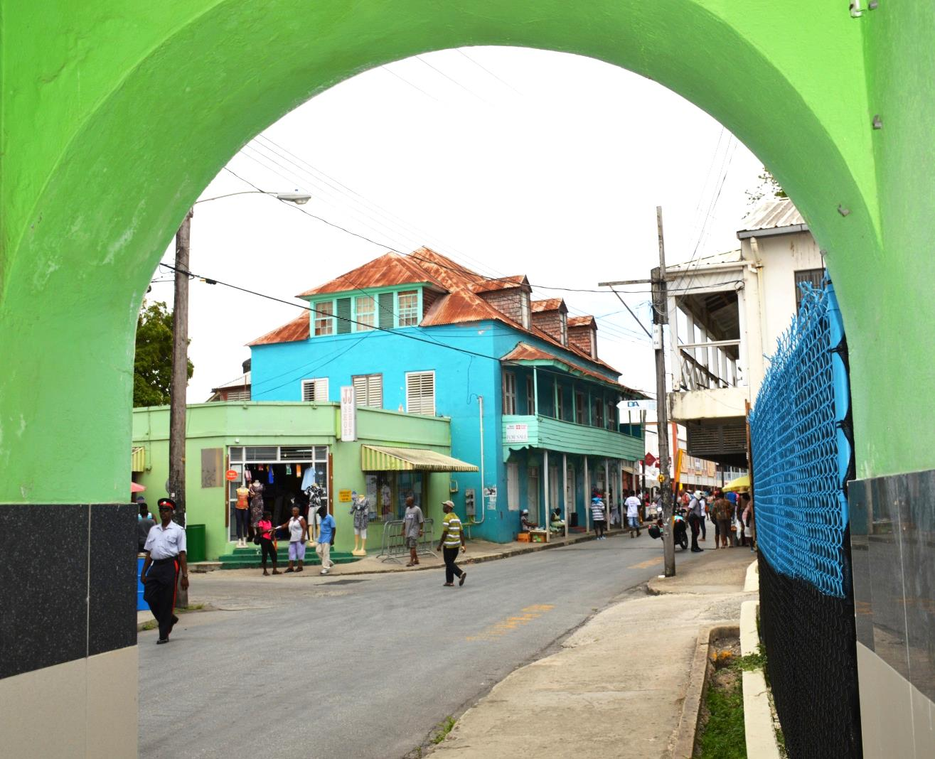
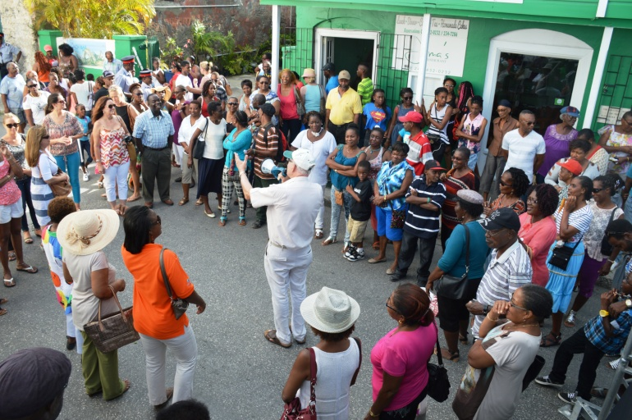
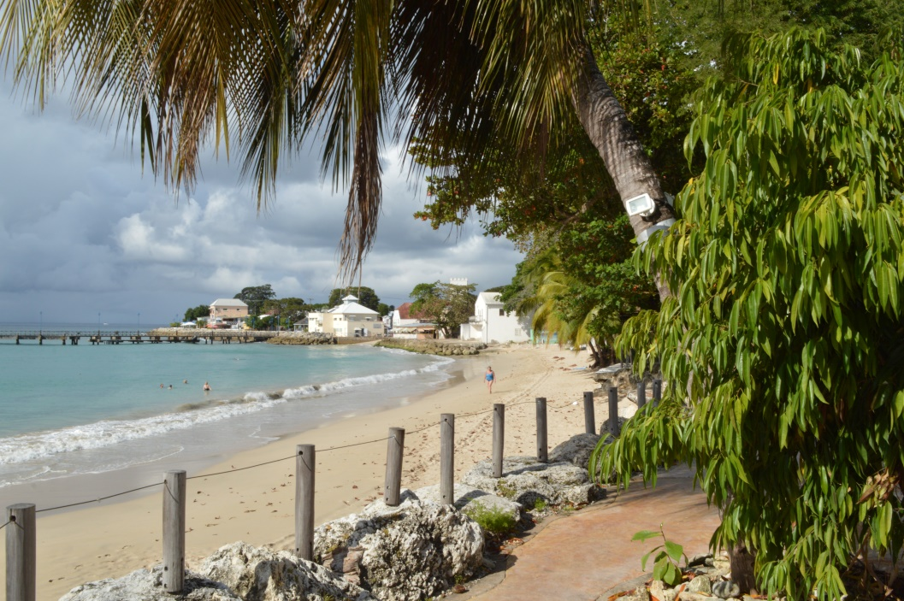
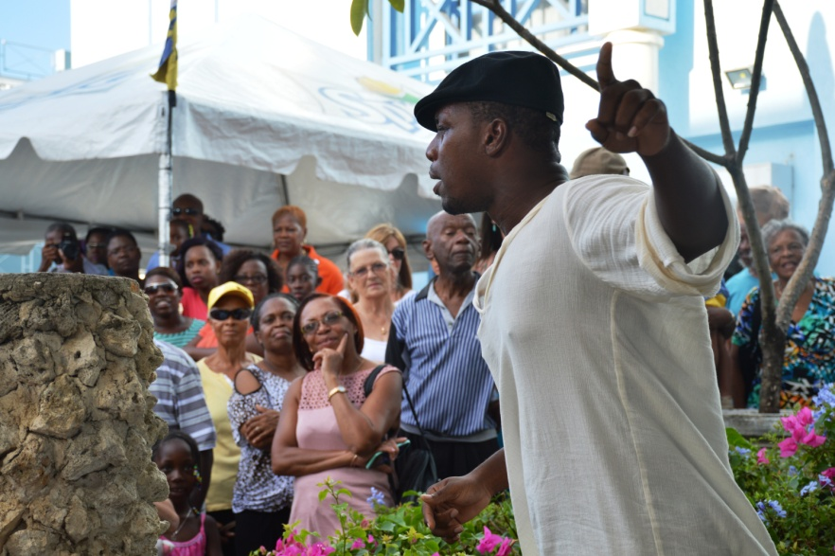
Speightstown streets and waterfront

Slide 22
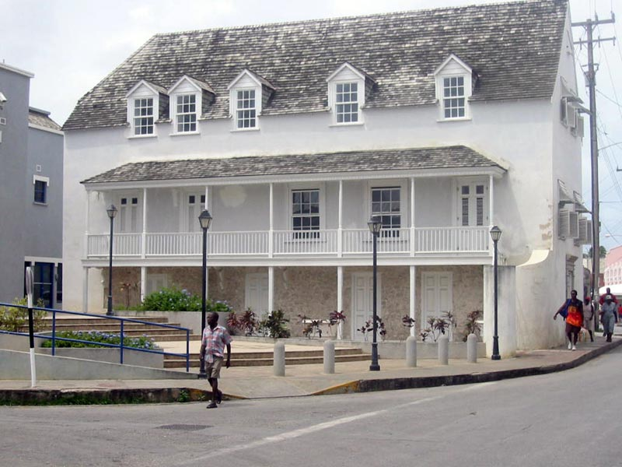
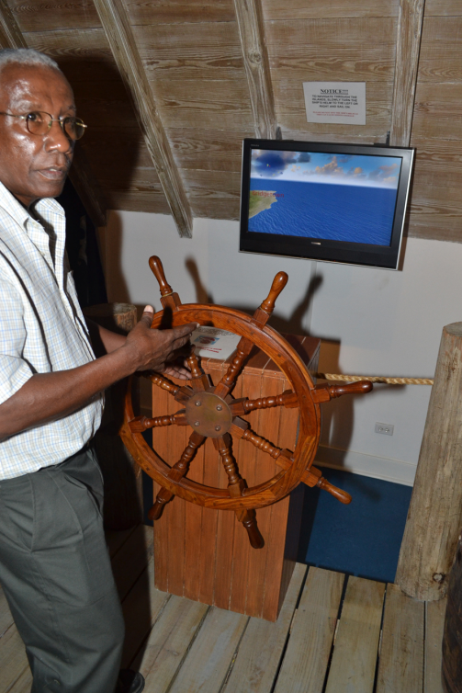
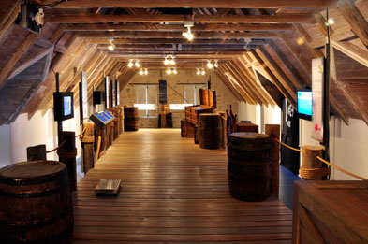

Slide 23
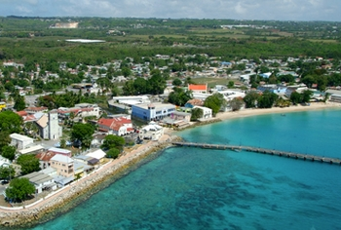
Fast ferry service between Speighstown and Bridgetown to avoid road traffic between both centres

Slide 24
St. Nicholas Abbey Plantation House, 1650s

Slide 26
Income generation and employment from the heritage product

Slide 27
Morgan Lewis Mill:
an iconic site in need of value added for income generation

Slide 28
GUN HILL: Visitor activity and income generation integrated with community action

Slide 29
Frank Collymore Hall
Empire Theatre
Three theatres within less than a quarter mile of each other. How do you make them sustainable?
Queens Park House and Theatre

Slide 30
Bridgetown, Barbados

